Slide 1


The Mathematical Toolkit
04
PART I · FOUNDATIONS OF DATA
CHAPTER 4 · WEEK 2
Data Science — From Foundations to Intelligent Systems
LECTURER
Dr. Mustafa Hameed
THE ISLAMIA UNIVERSITY OF BAHAWALPUR
Bahawalpur, Pakistan
Department of Information Technology · BSIT · Fall 2026
Notes:
Chapter 4: The Mathematical Toolkit. Part 1 — Foundations of Data. Week 2: Data and the mathematical toolkit. Handout pages 23–28.

Slide 2

Where this chapter sits
THE COURSE
PART I
PART II
PART III
PART IV
PART V
PART VI
1
2
3
4
5
6
7
8
9
10
11
12
13
14
15
16
17
18
19
20
21
22
23
24
25
26
27
28
29
30
31
32
The Mathematical Toolkit
BUILDS ON
USED LATER IN
Ch 3 Data: Types, Sources and Quality
Ch 5 Describing Data: Centre, Spread and Shape
Ch 11 Machine Learning Fundamentals
Ch 12 Supervised Learning I: Regression
Ch 13 Supervised Learning II: Classification
Ch 16 Unsupervised Learning and Anomaly Detection
Data Science · Chapter 4 · The Mathematical Toolkit
Handout p. 23 2
Notes:
Place the chapter. Before you start: Chapter 3 — observations, features and measurement scales. Nothing beyond school algebra is assumed. If the prerequisite self-check troubled you, work this chapter slowly; everything later depends on it.

Slide 3

What you will be able to do
LEARNING OUTCOMES
By the end of this chapter you will be able to:
1
Represent an observation as a vector and a dataset as a matrix, and state what each dimension means.
2
Compute a dot product and a Euclidean distance by hand, and explain what each measures about two observations.
3
Interpret a derivative as a slope and a gradient as a direction of steepest increase.
4
Trace one step of gradient descent numerically.
5
Explain why every model in this book is ultimately an optimisation problem.
Data Science · Chapter 4 · The Mathematical Toolkit
Handout p. 23 3
Notes:
Read these out: they are the chapter's contract with the room. Each click adds one.

Slide 4

Vocabulary for this chapter
KEY TERMS
scalar
vector
matrix
dot product
norm
Euclidean distance
cosine similarity
function
derivative
slope
gradient
minimum
learning rate
gradient descent
Each term is defined where it first matters — not here.
Data Science · Chapter 4 · The Mathematical Toolkit
Handout p. 23 4
Notes:
Do not define these now; they arrive one at a time. This slide is for the students' notes. Terms: scalar; vector; matrix; dot product; norm; Euclidean distance; cosine similarity; function; derivative; slope; gradient; minimum; learning rate; gradient descent.

Slide 5

In this chapter
IN THIS CHAPTER
4.1
Why Mathematics, and How Much
p. 23 ›
4.2
Vectors: One Observation
p. 23 ›
4.3
Functions, Slopes and Gradients
p. 25 ›
4.4
Gradient Descent
p. 25 ›
Data Science · Chapter 4 · The Mathematical Toolkit
Handout pp. 23–28 5
Notes:
The route through the chapter. Each row is a link: click it to jump to that section in the slide show.

Slide 6

The One-Sentence Summary of Machine Learning
CONCEPT
Put the data in a matrix, define a number that says how wrong you are, and roll downhill until that number stops getting smaller. Everything in Parts III and IV is a variation on this sentence.
Data Science · Chapter 4 · The Mathematical Toolkit
§4.1 · Handout p. 23 6
Notes:
Every model in this book does the same two things: it represents data as numbers arranged in a particular shape, and it searches for the arrangement of its own parameters that makes its errors smallest. The first is linear algebra; the second is calculus. That is the whole of the mathematics you need, and this chapter covers it at the depth this course requires — intuition, notation, and the ability to do a small example by hand.

Slide 7
Vectors: One Observation
SECTION 2 OF 4
4.2
4.1 Why Mathematics, and How Much
4.2 Vectors: One Observation
4.3 Functions, Slopes and Gradients
4.4 Gradient Descent
Data Science · Chapter 4
Handout §4.2 7
Notes:
Pause. Name the question this section answers.

Slide 8

Scalar, Vector, Matrix
DEFINITION
A scalar is a single number (5, −2.3). A vector is an ordered list of numbers, written x = [x₁, x₂, …, x_{p}] — one observation with p features. A matrix is a rectangular grid, written X with n rows and p columns — a whole dataset.
Data Science · Chapter 4 · The Mathematical Toolkit
§4.2 · Handout p. 23 8
Notes:
Read the box aloud, then ask for an example from the room before moving on.

Slide 9
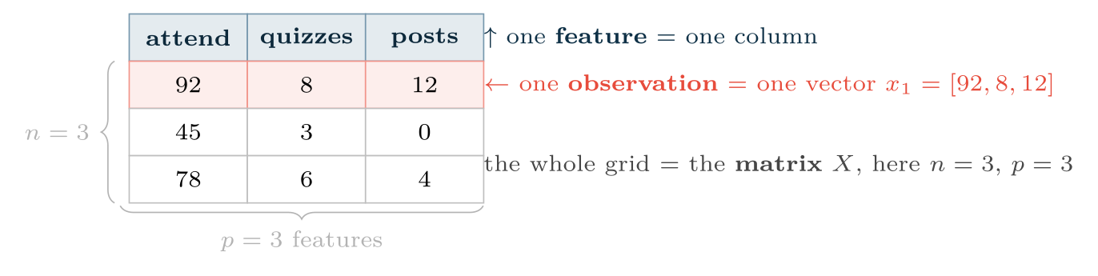
A dataset as a matrix
FIGURE 4.1
Every algorithm in this book consumes exactly this object: n rows of p numbers. Making real-world data fit this shape is the work of Chapter 7.
Data Science · Chapter 4 · The Mathematical Toolkit
§4.2 · Handout p. 23 9
Notes:
A student described by (attendance 92%, quizzes 8, forum posts 12) is the vector x = [92, 8, 12]. That is not an analogy; it is literally how the data is stored and how every algorithm sees it.
Figure 4.1 (handout p. 24): A dataset as a matrix. Every algorithm in this book consumes exactly this object: n rows of p numbers. Making real-world data fit this shape is the work of Chapter 7.

Slide 10
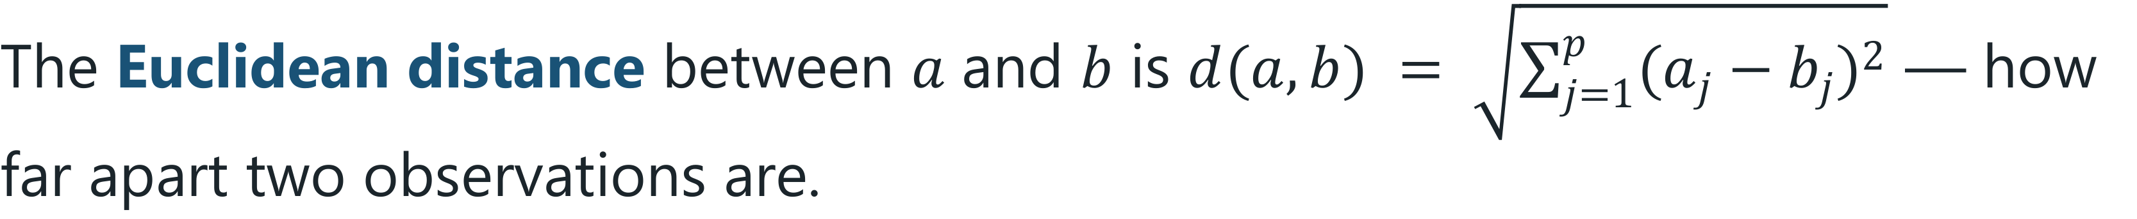
Norm, Distance, Dot Product
DEFINITION
The norm (length) of x is ‖x‖ = √(x₁² + … + x_{p}²).
Data Science · Chapter 4 · The Mathematical Toolkit
§4.2.1 · Handout p. 24 10
Notes:
Three operations on vectors carry almost all the geometric intuition you need.

Slide 11

Distance Between Two Students
WORKED EXAMPLE
a = [92, 8, 12] (engaged), b = [45, 3, 0] (disengaged).
Differences: 92−45 = 47, 8−3 = 5, 12−0 = 12.
Squares: 47² = 2209, 5² = 25, 12² = 144.
Sum: 2209 + 25 + 144 = 2378.
Distance: d(a,b) = √(2378) ≈ 48.8.
The lesson hiding in this number. The attendance difference (47) supplied 2209/2378 = 93% of the total. Attendance dominates purely because it is measured on a 0–100 scale while the others run 0–20. The distance is not measuring similarity of students; it is measuring similarity of attendance. This is exactly why Chapter 7 insists on scaling features before any distance-based method (k-NN in Chapter 13, k-means in Chapter 16) is used.
Data Science · Chapter 4 · The Mathematical Toolkit
§4.2.1 · Handout p. 24 11
Notes:
Each click adds one step of the working. Ask for the next number before you reveal it.

Slide 12
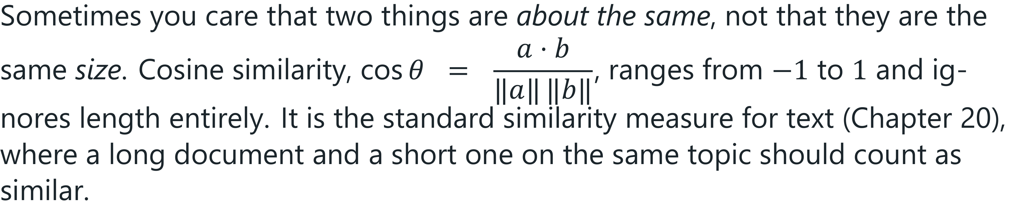
Cosine Similarity: Direction Without Magnitude
CONCEPT
Data Science · Chapter 4 · The Mathematical Toolkit
§4.2.1 · Handout p. 24 12
Notes:
Read the box aloud, then ask for an example from the room before moving on.

Slide 13
Functions, Slopes and Gradients
SECTION 3 OF 4
4.3
4.1 Why Mathematics, and How Much
4.2 Vectors: One Observation
4.3 Functions, Slopes and Gradients
4.4 Gradient Descent
Data Science · Chapter 4
Handout §4.3 13
Notes:
Pause. Name the question this section answers.

Slide 14
Derivative
DEFINITION
The derivative of f at a point, written f′(x) or df/dx, is the slope of f there: how much f changes per unit change in x. Where the derivative is zero, the function is momentarily flat — at a peak, a valley or a plateau.
Data Science · Chapter 4 · The Mathematical Toolkit
§4.3 · Handout p. 25 14
Notes:
Read the box aloud, then ask for an example from the room before moving on.

Slide 15
Functions, Slopes and Gradients
IN BRIEF
For this course you need three derivatives and one rule:
Data Science · Chapter 4 · The Mathematical Toolkit
§4.3 · Handout p. 25 15
Notes:
For this course you need three derivatives and one rule:

Slide 16
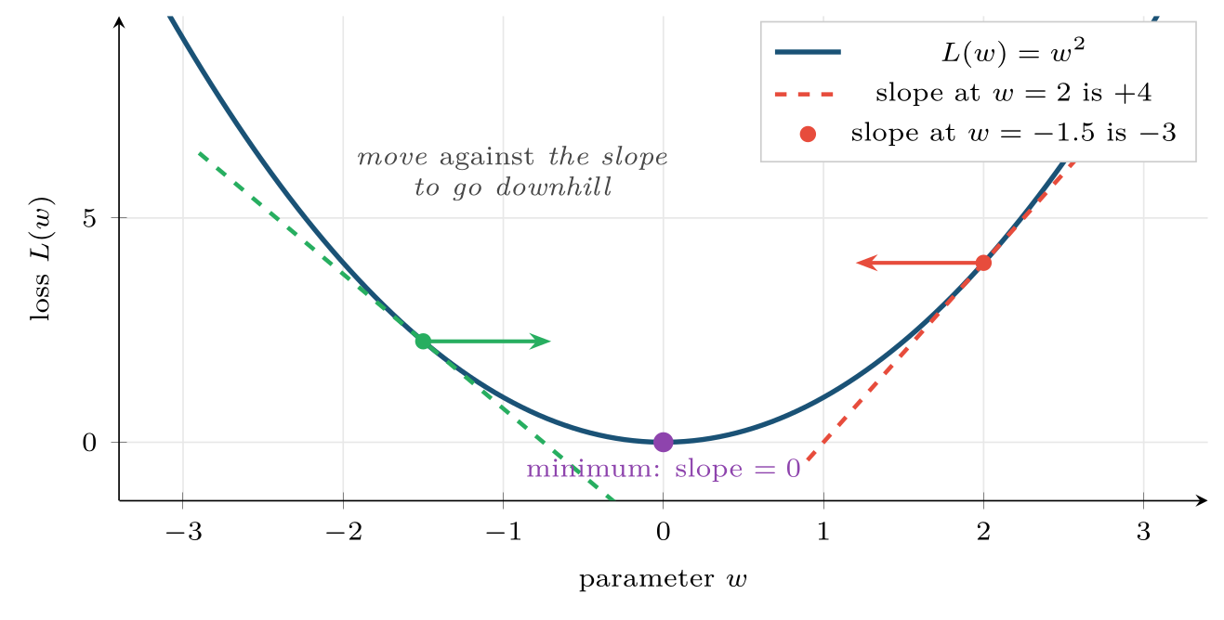
Slope as the guide to the minimum
FIGURE 4.2
Where the slope is positive the minimum lies to the left; where it is negative, to the right. In both cases you move in the direction opposite the sign of the derivative — which is the entire idea of gradient descent.
Data Science · Chapter 4 · The Mathematical Toolkit
§4.3 · Handout p. 25 16
Notes:
Figure 4.2 (handout p. 25): Slope as the guide to the minimum. Where the slope is positive the minimum lies to the left; where it is negative, to the right. In both cases you move in the direction opposite the sign of the derivative — which is the entire idea of gradient descent.

Slide 17
Gradient
DEFINITION
When a function has several inputs, the gradient ∇ L is the vector of its partial derivatives — one slope per parameter. It points in the direction of steepest increase, so −∇ L points downhill.
Data Science · Chapter 4 · The Mathematical Toolkit
§4.3 · Handout p. 25 17
Notes:
Read the box aloud, then ask for an example from the room before moving on.

Slide 18
Gradient Descent
SECTION 4 OF 4
4.4
4.1 Why Mathematics, and How Much
4.2 Vectors: One Observation
4.3 Functions, Slopes and Gradients
4.4 Gradient Descent
Data Science · Chapter 4
Handout §4.4 18
Notes:
Pause. Name the question this section answers.

Slide 19
Gradient Descent
DEFINITION
Repeat until the loss stops improving:
where w are the parameters, L is the loss, ∇ L is its gradient, and α is the learning rate — how big a step to take.
Data Science · Chapter 4 · The Mathematical Toolkit
§4.4 · Handout p. 25 19
Notes:
This is the algorithm that trains almost every model in Parts III and IV. It is three lines long.

Slide 20
Three Steps of Gradient Descent by Hand
WORKED EXAMPLE
Minimise L(w) = w², starting at w₀ = 3, with learning rate α = 0.3. The gradient is ∇ L = 2w.
Step 1. ∇ L(3) = 6. w₁ = 3 − 0.3 × 6 = 3 − 1.8 = 1.2. L = 1.44.
Step 2. ∇ L(1.2) = 2.4. w₂ = 1.2 − 0.3 × 2.4 = 1.2 − 0.72 = 0.48. L = 0.23.
Step 3. ∇ L(0.48) = 0.96. w₃ = 0.48 − 0.3 × 0.96 = 0.48 − 0.288 = 0.192. L = 0.037.
The loss fell from 9 to 0.037 in three steps, and w is converging on the true minimum at 0. Notice the steps get smaller automatically: near the minimum the gradient is small, so the algorithm slows down as it arrives. Nobody had to program that.
Now try α = 1.2. w₁ = 3 − 1.2 × 6 = −4.2; w₂ = −4.2 − 1.2×(−8.4) = 5.88. The loss is rising. Too large a learning rate overshoots and diverges — which is the subject of the next figure.
Data Science · Chapter 4 · The Mathematical Toolkit
§4.4 · Handout p. 25 20
Notes:
Each click adds one step of the working. Ask for the next number before you reveal it.

Slide 21
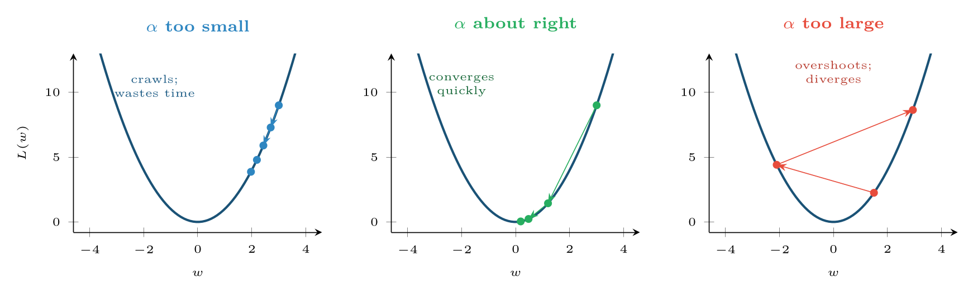
The learning rate is the single most important hyperparameter you will tune
FIGURE 4.3
Too small wastes compute; too large diverges. Chapter 17 returns to this with real training curves.
Data Science · Chapter 4 · The Mathematical Toolkit
§4.4 · Handout p. 25 21
Notes:
Figure 4.3 (handout p. 26): The learning rate is the single most important hyperparameter you will tune. Too small wastes compute; too large diverges. Chapter 17 returns to this with real training curves.

Slide 22

Common pitfalls
COMMON PITFALLS
✕
Computing distances on unscaled features. The feature with the biggest numeric range silently becomes the only feature that matters.
✕
Assuming a zero gradient means the best answer. It means flat. For the bowl-shaped losses of Chapter 12 that is the global minimum; for the neural networks of Chapter 17 it need not be.
✕
Treating the learning rate as unimportant. It decides whether training works at all.
Data Science · Chapter 4 · The Mathematical Toolkit
§4.4 · Handout p. 25 22
Notes:
For each pitfall, ask who has seen it happen. One real story beats five bullets.

Slide 23





Four lenses: Vectors, Distance and Optimisation
FOUR LENSES
LEARNING ANALYTICS
PROJECT MANAGEMENT
Each student becomes a vector of engagement features.
Each completed task becomes a vector (estimated hours, actual hours, number of dependencies, team size).
INTERNET OF THINGS
CYBERSECURITY
A one-minute window of sensor readings becomes a vector.
A network session becomes a vector (bytes in, bytes out, duration, packet count, distinct ports).
Data Science · Chapter 4 · The Mathematical Toolkit
Handout p. 28 23
Notes:
The same method, four domains. Each of the next four slides opens one lens in full.

Slide 24

Learning Analytics: Vectors, Distance and Optimisation
FOUR LENSES
LEARNING ANALYTICS
Project Management
Each student becomes a vector of engagement features. Euclidean distance between two students answers “who behaves like whom”, which is what drives peer grouping and the clustering of Chapter 16. The scaling warning matters acutely here: attendance on 0–100 will otherwise drown quiz counts on 0–10.
Internet of Things
Cybersecurity
Data Science · Chapter 4 · The Mathematical Toolkit
Handout p. 28 24
Notes:
Learning Analytics. Each student becomes a vector of engagement features. Euclidean distance between two students answers “who behaves like whom”, which is what drives peer grouping and the clustering of Chapter 16. The scaling warning matters acutely here: attendance on 0–100 will otherwise drown quiz counts on 0–10.

Slide 25

Project Management: Vectors, Distance and Optimisation
FOUR LENSES
PROJECT MANAGEMENT
Learning Analytics
Each completed task becomes a vector (estimated hours, actual hours, number of dependencies, team size). Distance identifies the historical tasks most similar to a new one, giving a defensible estimate — “the five most similar past tasks took 11–16 hours” — rather than a guess.
Internet of Things
Cybersecurity
Data Science · Chapter 4 · The Mathematical Toolkit
Handout p. 28 25
Notes:
Project Management. Each completed task becomes a vector (estimated hours, actual hours, number of dependencies, team size). Distance identifies the historical tasks most similar to a new one, giving a defensible estimate — “the five most similar past tasks took 11–16 hours” — rather than a guess.

Slide 26

Internet of Things: Vectors, Distance and Optimisation
FOUR LENSES
INTERNET OF THINGS
Learning Analytics
A one-minute window of sensor readings becomes a vector. Distance from the fleet’s normal-operation vector is the simplest possible anomaly score, and it runs in a few arithmetic operations — which is why it can execute on the device itself, at the edge (Chapter 24).
Project Management
Cybersecurity
Data Science · Chapter 4 · The Mathematical Toolkit
Handout p. 28 26
Notes:
Internet of Things. A one-minute window of sensor readings becomes a vector. Distance from the fleet’s normal-operation vector is the simplest possible anomaly score, and it runs in a few arithmetic operations — which is why it can execute on the device itself, at the edge (Chapter 24).

Slide 27

Cybersecurity: Vectors, Distance and Optimisation
FOUR LENSES
CYBERSECURITY
Learning Analytics
A network session becomes a vector (bytes in, bytes out, duration, packet count, distinct ports). Cosine similarity to known attack signatures ignores volume and compares shape, so a slow, low-volume version of an attack still resembles the fast one. Attackers routinely change magnitude; changing shape is harder.
Project Management
Internet of Things
Data Science · Chapter 4 · The Mathematical Toolkit
Handout p. 28 27
Notes:
Cybersecurity. A network session becomes a vector (bytes in, bytes out, duration, packet count, distinct ports). Cosine similarity to known attack signatures ignores volume and compares shape, so a slow, low-volume version of an attack still resembles the fast one. Attackers routinely change magnitude; changing shape is harder.

Slide 28

Try it yourself: Distance and Descent from First Principles
TRY IT YOURSELF
WHAT YOU WILL DO
1. Vectors and distance
2. Gradient descent on L(w) = w^2
THIS WEEK'S LAB
WHAT YOU WILL RUN
RUNNABLE COPY
Week 2: Ten-minute audit; distance & descent
1 listing, 24 lines of Python
code/ch04_distance_descent.py
Data Science · Chapter 4 · The Mathematical Toolkit
§4.4 · Handout p. 25 28
Notes:
Say what the room will have at the end of the lab, then let them start. Circulate rather than lecture.

Slide 29
Distance and Descent from First Principles
LAB · STEP 1 OF 3
Set-up
Python · code/ch04_distance_descent.py
1
import numpy as np
Data Science · Chapter 4 · The Mathematical Toolkit
§4.4 · Handout p. 25 29
Notes:
Step 1: Set-up. Read the code aloud; ask what each line would print before running it.

Slide 30
Distance and Descent from First Principles
LAB · STEP 2 OF 3
Vectors and distance
Python · code/ch04_distance_descent.py
2
3
4
5
6
7
8
9
10
11
12
13
14
# --- vectors and distance -------------------------------------------
a = np.array([92, 8, 12]) # engaged student
b = np.array([45, 3, 0]) # disengaged student
print("dot product :", a @ b)
print("norm of a :", np.linalg.norm(a))
print("distance a-b:", np.linalg.norm(a - b)) # ~48.8
# Now scale each feature to 0-1 and recompute: the answer changes a lot,
# because attendance no longer dominates purely by having a bigger range.
lo, hi = np.array([0,0,0]), np.array([100, 10, 25])
a_s, b_s = (a - lo)/(hi - lo), (b - lo)/(hi - lo)
print("scaled distance:", np.linalg.norm(a_s - b_s))
Data Science · Chapter 4 · The Mathematical Toolkit
§4.4 · Handout p. 25 30
Notes:
Step 2: Vectors and distance. Read the code aloud; ask what each line would print before running it.

Slide 31
Distance and Descent from First Principles
LAB · STEP 3 OF 3
Gradient descent on L(w) = w^2
Python · code/ch04_distance_descent.py
15
16
17
18
19
20
21
22
# --- gradient descent on L(w) = w^2 ---------------------------------
w, alpha = 3.0, 0.3
for step in range(6):
grad = 2 * w # dL/dw
w = w - alpha * grad
print(f"step {step+1}: w={w:7.4f} L={w**2:8.5f}")
# Change alpha to 1.2 and run again -- watch the loss increase.
Data Science · Chapter 4 · The Mathematical Toolkit
§4.4 · Handout p. 25 31
Notes:
Step 3: Gradient descent on L(w) = w^2. Read the code aloud; ask what each line would print before running it.

Slide 32

Compute the Euclidean distance between [3, 4] and [0, 0].
CHECKPOINT 1 OF 3
Discuss with the person next to you, then advance.
Data Science · Chapter 4 · The Mathematical Toolkit
Handout p. 28 · answers in Appendix D 32
Notes:
Ask the room. Do not advance until someone commits to an answer.

Slide 33

Compute the Euclidean distance between [3, 4] and [0, 0].
CHECKPOINT 1 OF 3 · ANSWER
√(3²+4²)=√(25)=5.
Data Science · Chapter 4 · The Mathematical Toolkit
Handout p. 28 · answers in Appendix D 33
Notes:
Answer (Appendix D): √(32+42)=√(25)=5.

Slide 34
L(w) = w² and you are at w = −2. What is the gradient, and does gradient descent move w left or right?
CHECKPOINT 2 OF 3
Discuss with the person next to you, then advance.
Data Science · Chapter 4 · The Mathematical Toolkit
Handout p. 28 · answers in Appendix D 34
Notes:
Ask the room. Do not advance until someone commits to an answer.

Slide 35
L(w) = w² and you are at w = −2. What is the gradient, and does gradient descent move w left or right?
CHECKPOINT 2 OF 3 · ANSWER
∇ L = 2w = −4. The update is w ← w − α(−4), which increases w — so it moves right, towards the minimum at 0.
Data Science · Chapter 4 · The Mathematical Toolkit
Handout p. 28 · answers in Appendix D 35
Notes:
Answer (Appendix D): ∇ L = 2w = −4. The update is w ← w − α(−4), which increases w — so it moves right, towards the minimum at 0.

Slide 36
Two documents have cosine similarity 0.95 but Euclidean distance 40. What does that combination tell you about them?
CHECKPOINT 3 OF 3
Discuss with the person next to you, then advance.
Data Science · Chapter 4 · The Mathematical Toolkit
Handout p. 28 · answers in Appendix D 36
Notes:
Ask the room. Do not advance until someone commits to an answer.

Slide 37
Two documents have cosine similarity 0.95 but Euclidean distance 40. What does that combination tell you about them?
CHECKPOINT 3 OF 3 · ANSWER
They are about the same subject (direction is nearly identical) but very different in magnitude — typically a long document and a short one on the same topic. This is exactly the case where cosine similarity is right and Euclidean distance is misleading.
Data Science · Chapter 4 · The Mathematical Toolkit
Handout p. 28 · answers in Appendix D 37
Notes:
Answer (Appendix D): They are about the same subject (direction is nearly identical) but very different in magnitude — typically a long document and a short one on the same topic. This is exactly the case where cosine similarity is right and Euclidean distance is misleading.

Slide 38

What to take away
CHAPTER SUMMARY
1
An observation is a vector; a dataset is an n × p matrix. Every algorithm consumes this shape.
2
Euclidean distance measures dissimilarity; it is dominated by whichever feature has the largest scale, so scale first.
3
Cosine similarity compares direction while ignoring magnitude — the right choice for text.
4
A derivative is a slope; a gradient is a vector of slopes pointing steeply uphill.
5
Gradient descent is w ← w − α ∇ L. The learning rate α decides between crawling, converging and diverging.
Data Science · Chapter 4 · The Mathematical Toolkit
Handout p. 28 38
Notes:
Ask the room to say each takeaway before you reveal it.

Slide 39

Quick check 1 of 2
REVIEW · MULTIPLE CHOICE
The gradient of a loss function points in the direction of:
A
steepest decrease
B
steepest increase
C
the minimum
D
zero error
Data Science · Chapter 4 · The Mathematical Toolkit
Handout p. 28 39
Notes:
Take a show of hands for each option before discussing. (The handout does not print MCQ answers.)

Slide 40
Quick check 2 of 2
REVIEW · MULTIPLE CHOICE
For a dataset with 500 rows and 12 columns, the matrix X has dimensions:
A
12 × 500
B
500 × 12
C
500 × 500
D
12 × 12
Data Science · Chapter 4 · The Mathematical Toolkit
Handout p. 28 40
Notes:
Take a show of hands for each option before discussing. (The handout does not print MCQ answers.)

Slide 41
For your notebook
REVIEW QUESTIONS
SHORT
Compute ‖[6, 8]‖ and the distance between [6,8] and [2,5].
SHORT
Explain in your own words why gradient descent automatically takes smaller steps as it approaches a minimum.
SHORT
Give one scenario in which cosine similarity is clearly the right choice and Euclidean distance is clearly wrong.
APPLIED
Perform two steps of gradient descent by hand on L(w) = (w−4)² from w₀ = 0 with α = 0.4. (Hint: ∇ L = 2(w−4).) State the value of L after each step.
APPLIED
A colleague computes distances between servers using features {uptime in seconds, CPU load 0–1, error count 0–50}. Explain precisely what will go wrong and how to fix it.
Data Science · Chapter 4 · The Mathematical Toolkit
Handout p. 28 41
Notes:
Set these for independent study. Model answers are not printed in the handout.

Slide 42
End of Chapter 4
04
NEXT
READ
Chapter 5 — Describing Data: Centre, Spread and Shape
Handout Chapter 4, pages 23–28
THIS WEEK'S LAB
Ten-minute audit; distance & descent
Data Science · Chapter 4 · The Mathematical Toolkit
42
Notes:
Close. NEXT: Chapter 5 — Describing Data: Centre, Spread and Shape. READ: Handout Chapter 4, pages 23–28. THIS WEEK'S LAB: Ten-minute audit; distance & descent.

